Slide 1

Java Packages And Classpath
<date/time>
<footer>
1

Slide 2
Package
<date/time>
<footer>
1

Slide 3
Packages in Java
Package in java as the name suggests is a pack(group) of classes, interfaces and other packages.
Packages are used in Java in order to prevent naming conflicts, to control access, to make searching/locating and usage of classes, interfaces, enumerations and annotations easier, etc.

Slide 4
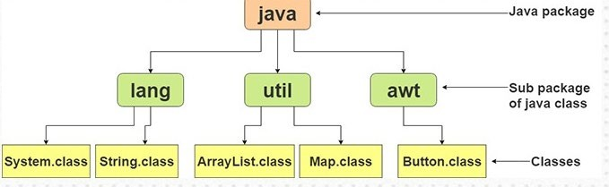
Packages in Java

Slide 5
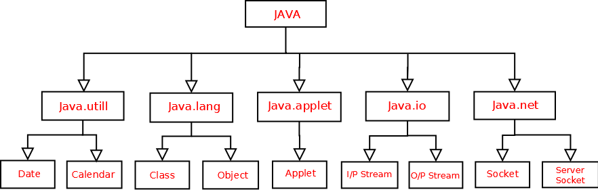
Packages in Java

Slide 6
Packages are used for:
Preventing naming conflicts. For example there can be two classes with name Teacher in two packages, college.staff.icse.Teacher and college.staff.cbse.Teacher
Making searching/locating and usage of classes, interfaces, enumerations and annotations easier.
Providing access control: protected and default have package level access control. A protected member is accessible by classes in the same package and its subclasses and subclasses in different package. A default member (without any access specifier) is accessible by classes in the same package only.
Packages can be considered as data encapsulation (or data-hiding).

Slide 7
Package in java can be categorized in two form,
built-in package and
user-defined package.
All we need to do is put related classes into packages. After that we can simply write a import a class from existing packages and use it in our program.
Package names and directory structure are closely related. For example if a package name is college.staff.cbse, then there are three directories, college, staff and cbse such that cbse is present in staff and staff is present college.

Slide 8
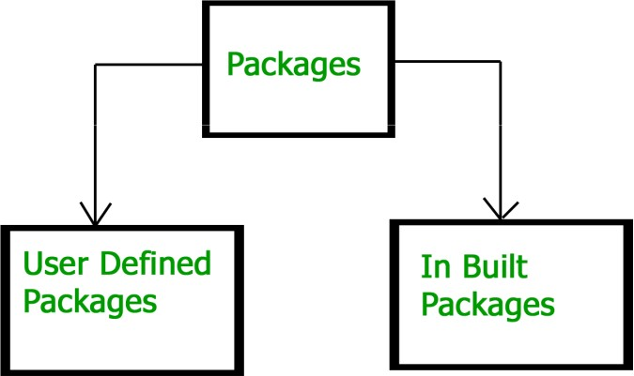
Packages in Java

Slide 9
Built-in Packages in Java

Slide 10
Java Foundation Packages
Java provides a large number of classes grouped into different packages based on their functionality.
The six foundation Java packages are:
java.lang - Contains classes for primitive types, strings, math functions, threads, and exception
java.util - Contains classes such as vectors, hash tables, date etc.
java.io - Stream classes for I/O
java.awt - Classes for GUI – windows, buttons, menus etc.
java.net - Classes for networking
java.applet - Classes for creating and implementing applets

Slide 11
Subpackages:
Packages that are inside another package are the subpackages.
These are not imported by default, they have to imported explicitly.
If you import a package, all the classes and interface of that package will be imported excluding the classes and interfaces of the subpackages. Hence, you need to import the subpackage as well.

Slide 12
Path & Classpath

Slide 13
Path
PATH and CLASSPATH are environment variables on Microsoft Windows, Solaris, and Linux.
An environment variable is a variable whose value is set outside the program, typically through functionality built into the operating system or microservice.
For example, a running process can query the value of the TEMP environment variable to discover a suitable location to store temporary files

Slide 14
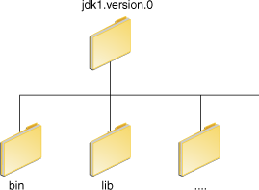
Path Variables
After installing the JDK software, thedirectory will have the structure shown below.
The bin directory contains both the compiler and the launcher.
These are the Paths for JDK

Slide 15
Update Path variables - Windows
Set the PATH environment variable if you want to be able to conveniently run the executables (javac.exe, java.exe, javadoc.exe, and so on) from any directory without having to type the full path of the command.
You can run Java applications just fine without setting the PATH environment variable. Or, you can optionally set it as a convenience.

Slide 16
Update Path variables - Windows
If you do not set the PATH variable, you need to specify the full path to the executable every time you run it, such as:
C:\Java\jdk1.7.0\bin\javac MyClass.java
If you set the PATH variable, below would be sufficient.
javac MyClass.java

Slide 17
Update Path variables - Windows
The PATH environment variable is a series of directories separated by semicolons (;).
Microsoft Windows looks for programs in the PATH directories in order, from left to right. You should have only one bin directory for the JDK in the path at a time.
The following is an example of a PATH environment variable:
C:\Java\jdk1.7.0\bin;C:\Windows\System32\;C:\Windows\;C
:\Windows\System32\Wbem
It is useful to set the PATH environment variable permanently so it will persist after rebooting.

Slide 18
Update Path variables - Windows
How to set the Temporary Path of JDK in Windows
set path=C:\Program Files\Java\jdk1.6.0_23\bin
How to set Permanent Path of JDK in Windows
Go to MyComputer properties -> Click on the advanced tab
->Click on environment variables->Click on the new tab of user variables -> Write the path in the variable name->Copy the path of bin folder ->Paste path of bin folder in the variable value -> Click on ok button

Slide 19
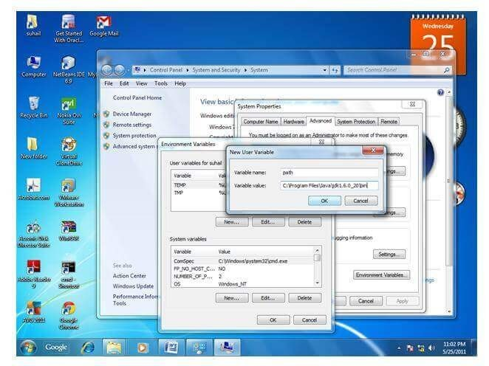
Update Path variables - Windows

Slide 20
Update Path variables - Linux
Setting path in Linux OS is the same as setting the path in the Windows OS. But, here we use the export tool rather than set.
export PATH=$PATH:/home/jdk1.6.01/bin/
Edit the startup file (~/.bashrc):
PATH=/usr/local/jdk1.7.0/bin:$PATH
export PATH

Slide 21
Classpath

Slide 22
Classpath
The CLASSPATH variable is one way to tell applications, including the JDK tools, where to look for user classes or third- party classes.
User Classes that are NOT part of the JRE, JDK platform.
The preferred way to specify the class path is by using the -cp command line switch. This allows the CLASSPATH to be set individually for each application without affecting other applications.
The default value of the class path is ".", meaning that only the current directory is searched. Specifying either the CLASSPATH variable or the -cp command line switch overrides this value.
●

Slide 23
Classpath - Example
package MyPack;
For a program to find MyPack, one of three things must be true.
Either the program can be executed from a directory immediately above MyPack OR
the CLASSPATH must be set to include the path to MyPack, OR
the -classpath option must specify the path to MyPack when the program is run via java
Suppose the path of MyPack directory is
C:\MyPrograms\Java\MyPack
– Then the class path to MyPack is C:\MyPrograms\Java
17-11-2022 23
●

Slide 24
Setting Classpath - Example
To modify the CLASSPATH, use the same procedure you used for the PATH variable.
Example
PATH=".:/usr/local/sbin:/usr/local/bin:/usr/sbin:/usr/bin:/sbin:/bin:/usr/ga mes"
JAVA_HOME="/usr/lib/jvm/java-1.5.0-sun/"
CLASSPATH=".:/usr/lib/jvm/java-1.5.0-sun/lib"
To run a Java program
java -cp . myfirstjavaprog

Slide 25
Access Protection

Slide 26
Access Protection
Addresses four categories of visibility for class members:
Subclasses in the same package
Non-subclasses in the same package
Subclasses in different packages
Classes that are neither in the same package nor subclasses

Slide 27
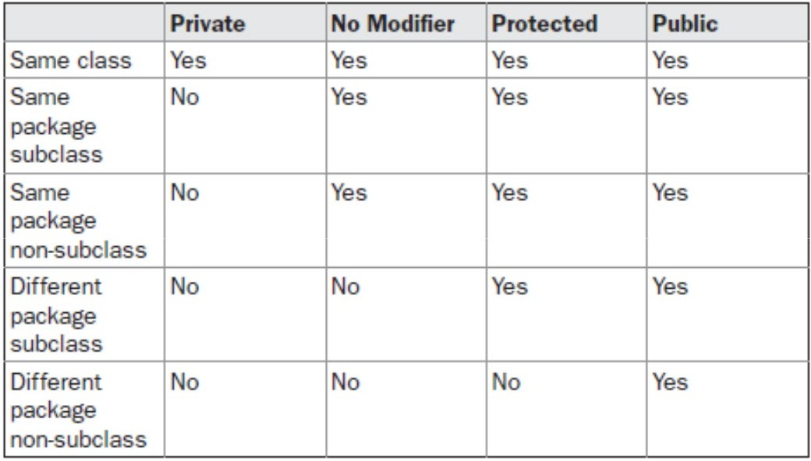
Access Protection

Slide 28
Importing Package

Slide 29
Importing Packages
All of the standard classes are stored in some named package.
If we want to use classes in some other packages, they must be fully qualified with their package name or names,. It is difficult to type in the long dot-separated package path name for every class we want to use.
TO SOLVE THIS PROBLEM, we can use import statement. The import statement helps to bring certain classes, or entire packages, into visibility.
To use a class or a package from the library, we need to use the import keyword

Slide 30
Importing Packages
General form of the import statement:
import pkg1[.pkg2].(classname|*);
Here, pkg1 is the name of a top-level package, and pkg2 is the name of a subordinate package inside the package pkg1 separated by a dot (.). Here square bracket denotes that it is optional.
E.g.
import pack1;// import the package pack1
import java.io.*;// import all the classes from the package java.io
import java.util.Date; //import the Date class from the package java.util

Slide 31
Importing Packages
All of the standard Java classes included with Java are stored in a package called java
The basic language functions are stored in a package inside of the java package called java.lang
it is implicitly imported by the compiler for all programs.

Slide 32
Importing Packages

Slide 33
Importing Packages
Using an import statement:
import java.util.*;
class MyDate extends Date {
//statements , methods,variables
}
Without the import statement looks like this:
class MyDate extends java.util.Date
{
}

Slide 34
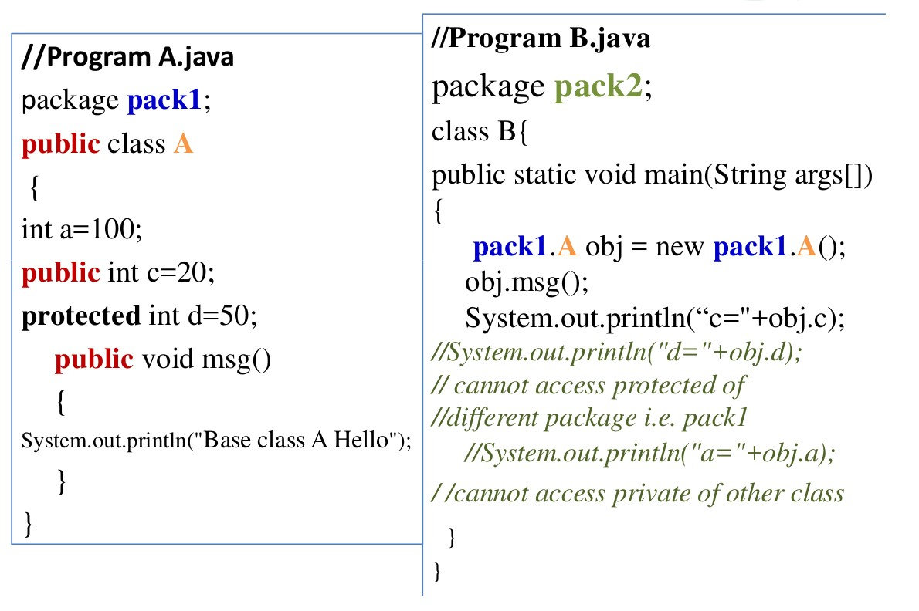
Importing Packages
Without Using import statement- we have to use class from other package as packagename.classname (fully quantified)

Slide 35
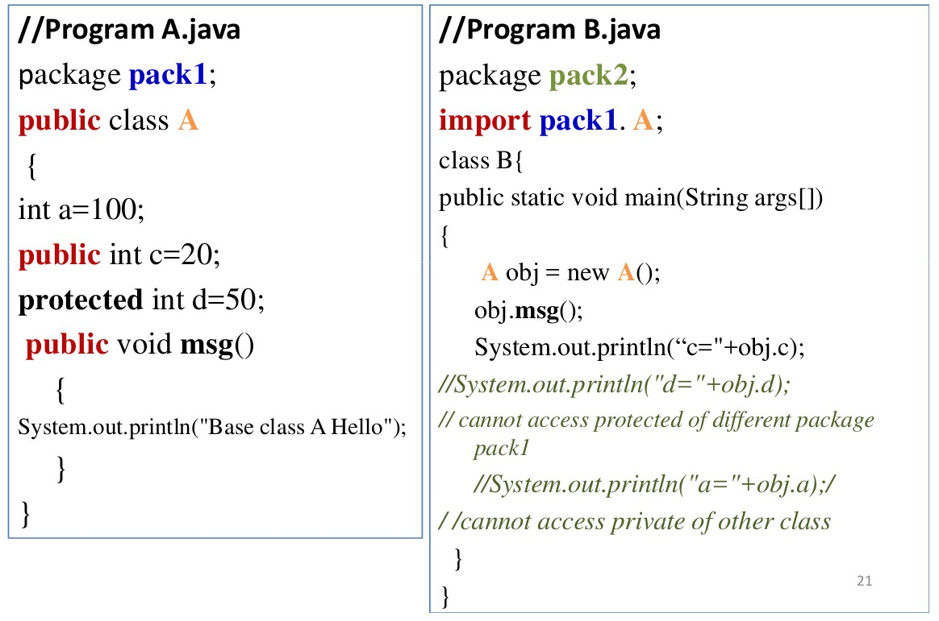
Importing Packages
Using import package.classname statement to import all classes in pack1 to program

Slide 36

Using import package.* statement to import all classes in pack1 to program

Slide 37
Example

Slide 38
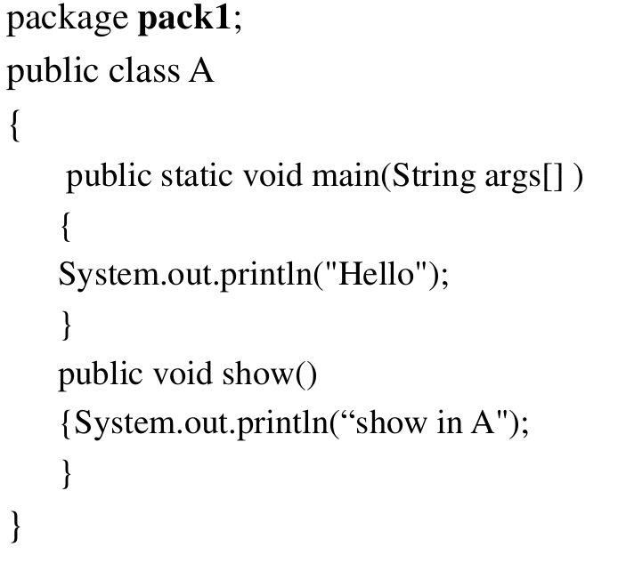
Sample 1
Create a folder pack1 inside D drive
Create a file A.java

Slide 39
Sample 1
Method 1
Take path before pack1 folder in command prompt here
it s D drive.
Compile using
D:\>javac pack1/A.java
To run
D:\>java pack1/A
Or D:\>java pack1.A

Slide 40
Sample
Method 2
Set classpath in command prompt to path to folder before the package pack1
C:\Users\USER>set CLASSPATH=;D:\
To compile
C:\Users\USER>javac -cp . D:\pack1\A.java
To run
C:\Users\USER>java pack1.A
Hello

Slide 41
Sample
Method 3:
Using –classpath option
Compile using
C:\Users\USER>javac D:\pack1\A.java
Or
C:\Users\USER>javac -classpath . D:\pack1\A.java
• Run using
C:\Users\USER>java -classpath D:\ pack1.A

Slide 42
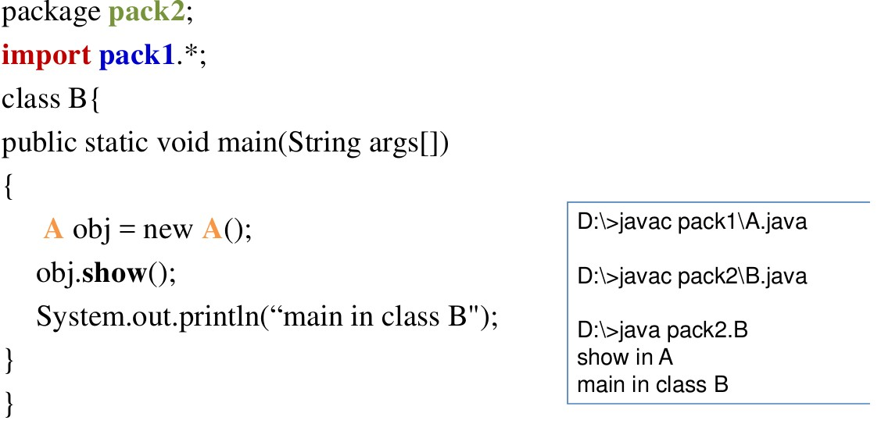
Sample 2
Create a folder pack2 inside D drive
Create a file B.java in it
17-11

Slide 43
Reference
Herbert Schildt, Java: The Complete Reference, 8/e, Tata McGraw Hill, 2011.
Oracle Java documentation
https://docs.oracle.com/javase/tutorial/essential/environment/path s.html
17-11-2022
43

Slide 44

Interfaces
<date/time>
<footer>
1

Slide 45
Interfaces
Using the keyword interface you can specify what a class must do, but not how it does it.
Interfaces are syntactically similar to classes, but they lack instance variables, and, as a general rule, their methods are declared without any body.
In practice, this means that you can define interfaces that don’t make assumptions about how they are implemented.
Once it is defined, any number of classes can implement an interface.
Also, one class can implement any number of interfaces.
17-11-2022
2

Slide 46
Interface
To implement an interface, a class must provide the complete set of methods required by the interface. However, each class is free to determine the details of its own implementation.
By providing the interface keyword, Java allows you to fully utilize the “one interface, multiple methods” aspect of polymorphism.
17-11-2022
3

Slide 47
Interface
Interfaces are designed to support dynamic method resolution at run time.
Normally, in order for a method to be called from one class to another, both classes need to be present at compile time so the Java compiler can check to ensure that the method signatures are compatible.
in a system like this, functionality will be available to more and more subclasses. Interfaces are designed to disconnect the definition of a method or set of methods from the inheritance hierarchy.
it is possible for classes that unrelated in terms of the class
¹⁷⁻¹h¹⁻i²e⁰²r²archy to implement the same interface.
4

Slide 48
Interface - Implementation
An interface is defined much like a class. This is a simplified general form of an interface:
●
accessspecifier interface name {
return-type method-name1(parameter-list); return-type method-name2(parameter-list); type final-varname1 = value;
type final-varname2 = value;
// ...
return-type method-nameN(parameter-list); type final-varnameN = value;
}
17-11-2022
5

Slide 49
Interface – Access Modifiers
Can use default and public access modifiers
When no access modifier is included, then default access results, and the interface is only available to other members of the package in which it is declared.
When it is declared as public, the interface can be used by code outside its package. In this case, the interface must be the only public interface declared in the file, and the file must have the same name as the interface.
17-11-2022
6

Slide 50
Interface – Variable declarations
Can use default and public access modifiers
When no access modifier is included, then default access results, and the interface is only available to other members of the package in which it is declared.
When it is declared as public, the interface can be used by code outside its package. In this case, the interface must be the only public interface declared in the file, and the file must have the same name as the interface.
17-11-2022
7

Slide 51
Interface – JDK Related Enhancements
Prior to JDK 8, an interface could not define any implementation whatsoever. This is the traditional form which define only “what” to implement.
Beginning with JDK 8, it is possible to add a default implementation to an interface method. This form define “what” and “How” to implement.
JDK 8 also added static interface methods, and beginning with
JDK 9, an interface can include private methods.
17-11-2022
8

Slide 52
Interface - key points
Interface can be created using the keyword interface.
Interfaces are syntactically similar to classes.
The methods in interface are declared without any body.
Interface never implements methods (before jdk 8)
Any number of classes can implement an interface.
One class can implement any number of interfaces.
This helps to achieve multiple inheritance.
To implement an interface, – a class must create and define the complete set of methods that are declared by the interface.
17-11-2022
9

Slide 53
Interface - key points
When no access specifier is included, then it has default access
The methods are declared have no bodies. They end with a semicolon after the parameter list.
They are abstract methods.
Each class that includes an interface must implement all of the methods.
ariables re implicitly final and static, meaning they cannot be changed by the implementing class. They must also be initialized
All methods and variables are implicitly public
JDK 8 provide function implementation and JDK 9 private access modifiers
17-11-2022
10

Slide 54
Interface - Example
interface Callback {
void show(int param);
}
17-11-2022
11

Slide 55
Once an interface has been defined, one or more classes can implement that interface.
To implement an interface, include the implements clause in a class definition, and then create the methods required by the interface.
The general form of a class that includes the implements clause looks like this:
17-11-2022
12

Slide 56
Implementing Interfaces
General form of a class that includes the implements clause
class classname [extends superclass] [implements interface [,interface...]] {
// class-body
}
//square bracket denotes optional
If a class implements more than one interface, the interfaces are separated with a comma
When we implement an interface method, it must be declared as public.
17-11-2022
13

Slide 57
Implementing Interfaces
interface Callback
{
void show(int param);
}
class Sample implements Callback {
public void show(int p) {
System.out.println(“show p= " +p);
}
//other methods
}
17-11-2022
14

Slide 58
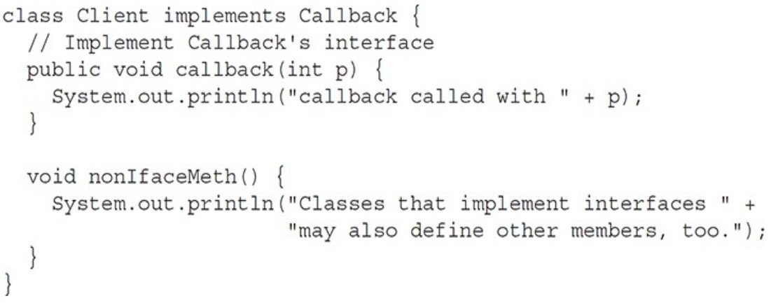
Implementing Interfaces
It is both permissible and common for classes that implement interfaces to define additional members of their own.
For example, the following version of Client implements callback( ) and adds the method nonIfaceMeth( ):
17-11-2022
15

Slide 59
Accessing Implementations Through Interface References
You can declare variables as object references that use an interface rather than a class type.
Any instance of any class that implements the declared interface can be referred to by such a variable.
When you call a method through one of these references, the correct version will be called based on the actual instance of the interface being referred to.
This is one of the key features of interfaces.
The method to be executed is looked up dynamically at run time, allowing classes to be created later than the code which calls methods on them.
The calling code can dispatch through an interface without having to know anything about the “callee.” This process is similar to using a superclass reference to access a subclass object.
17-11-2022
16

Slide 60
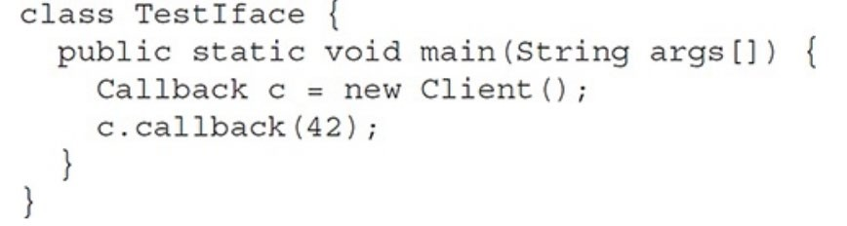
Accessing Implementations Through Interface References
The following example calls the callback( ) method via an interface reference variable
output of this program is shown here:
callback called with 42
17-11-2022
17

Slide 61
Accessing Implementations Through Interface References
Notice that variable c is declared to be of the interface type Callback, yet it was assigned an instance of Client.
Although c can be used to access the callback( ) method, it cannot access any other members of the Client class.
An interface reference variable has knowledge only of the methods declared by its interface declaration.
Thus, c could not be used to access nonIfaceMeth( ) since it is defined by Client but not Callback.
17-11-2022
18

Slide 62
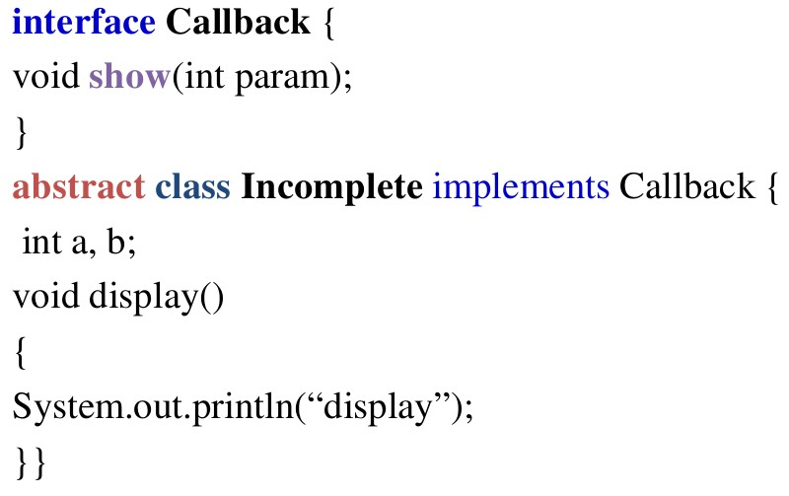
Partial Implementations
If a class includes an interface but does not fully implement the methods required by that interface, then that class must be declared as abstract
17-11-2022
19

Slide 63
Nested Interfaces
An interface can be declared a member of a class or another interface. Such an interface is called a member interface or a nested interface.
A nested interface can be declared as public, private, or protected. This differs from a top-level interface, which must either be declared as public or use the default access level
When a nested interface is used outside of its enclosing scope, it must be qualified by the name of the class or interface of which it is a member. Thus, outside of the class or interface in which a nested interface is declared, its name must be fully qualified by the name of the class or interface of which it is a member
17-11-2022
20

Slide 64
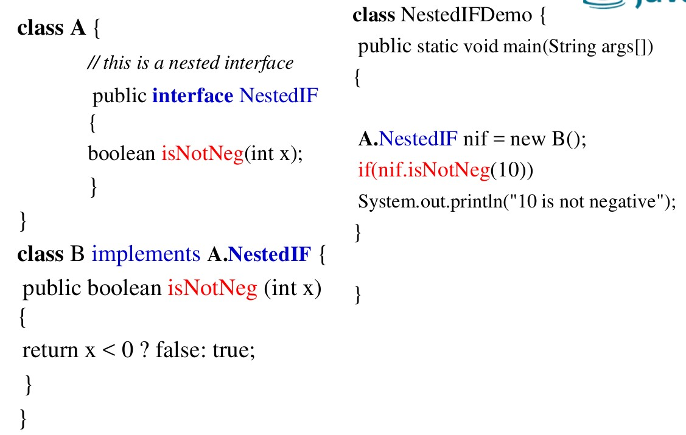
Nested Interfaces
●
●
17-11-2022
21

Slide 65
Applying Interfaces
Eg, Stack
There are multiple ways to implement stck, like array, linked list, binary tree and so on.
Requirement – No matter how stack implements, it should have exact function signature push() and pop().
Solution: define an interface stack with push() and pop(), and the implementations must implement interface stack
17-11-2022
22

Slide 66
Variables in Interfaces
You can use interfaces to import shared constants into multiple classes by simply declaring an interface that contains variables that are initialized to the desired values.
When we include an interface in a class (using “implement” the interface), all of those variable names in the interface will be in scope as constants.
– That is they are imported to class name space as final variables.
17-11-2022
23

Slide 67
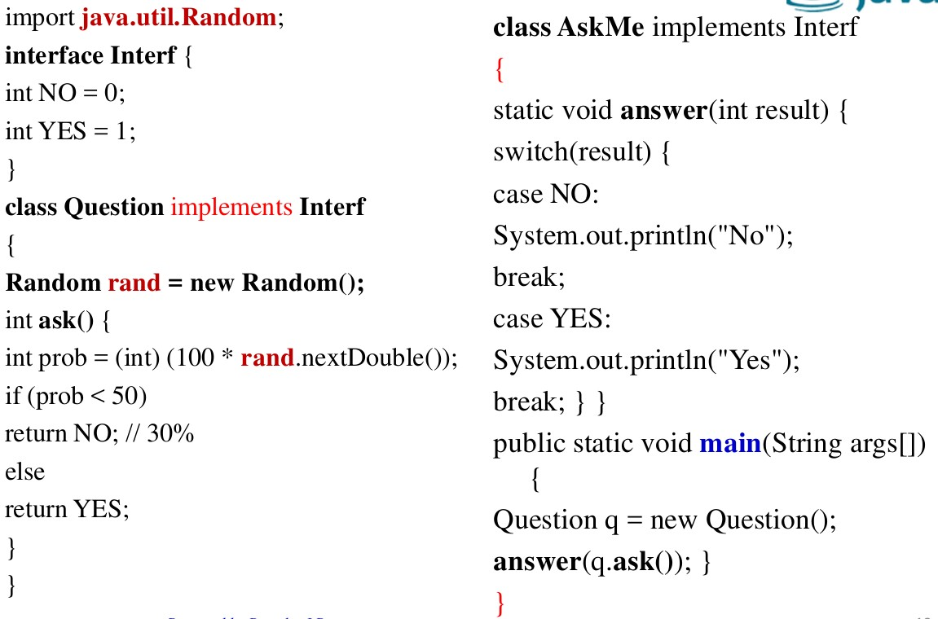
Variables in Interfaces
17-11-2022
24

Slide 68
Interfaces Can Be Extended
One interface can inherit another by use of the keyword extends.
When a class class1 implements an interface interface1 that inherits another interface interface2, then class1 must provide implementations for all methods defined within the interface inheritance chain(both interface1 and interface2).
17-11-2022
25

Slide 69
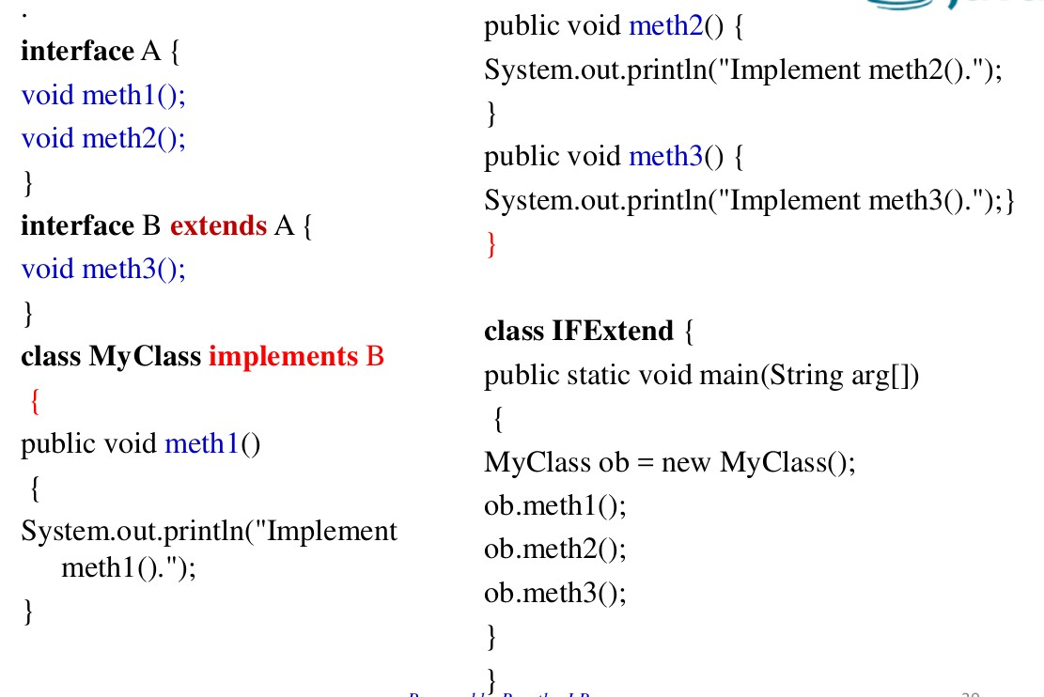
Interfaces Can Be Extended
17-11-2022
26

Slide 70
Deafult Method
prior to JDK 8, an interface could not define any implementation whatsoever. This meant that for all previous versions of Java, the methods specified by an interface were abstract, containing no body.
●
The release of JDK 8 changed this by adding a new capability to interface called the default method.
A default method lets you define a default implementation for an interface method. In other words, by use of a default method, it is possible for an interface method to provide a body, rather than being abstract. During its development, the default method was also referred to as an extension method
17-11-2022
27

Slide 71
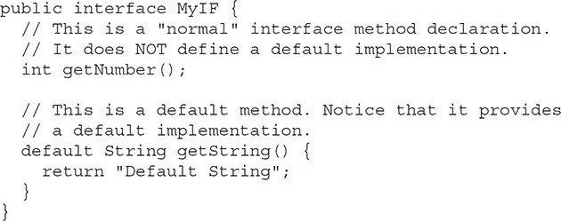
Deafult Method
Deafult Method - interface
17-11-2022
28

Slide 72
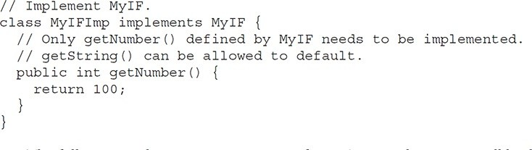
Deafult Method
Implementing interface
17-11-2022
29

Slide 73
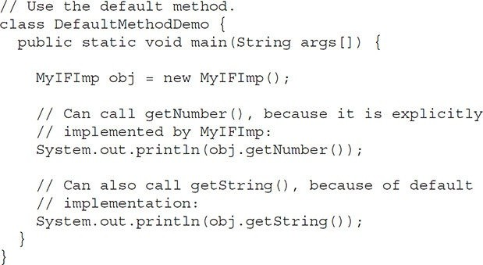
Deafult Method
Test class for default method implementation
17-11-2022
30

Slide 74
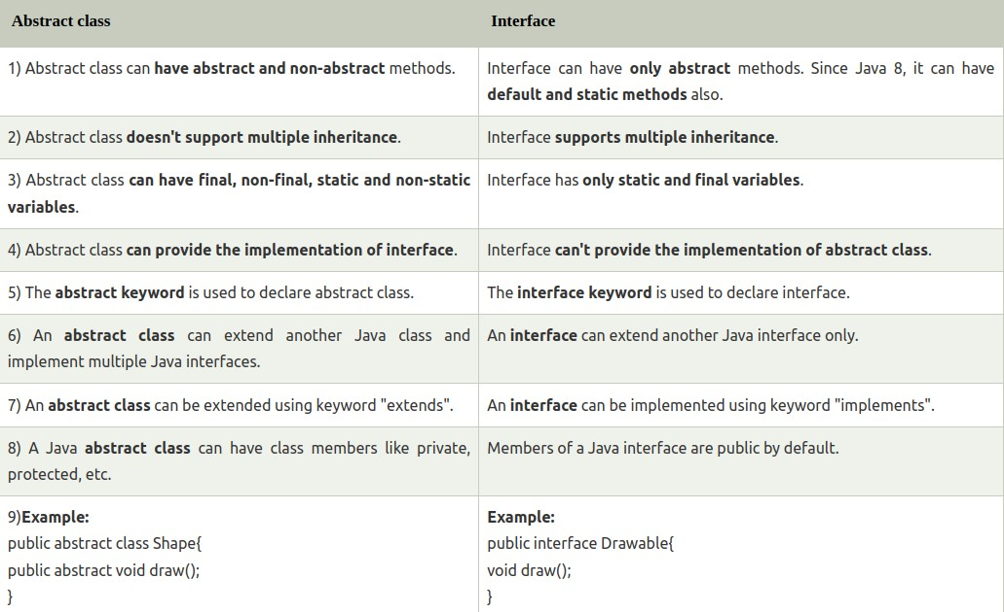
17-11-2022
31

Slide 75
Excercise
Develop a stack class by implementing interface Istack having void push(int a) and int pop()
Enhance this with default implementation having Istack function clear().
17-11-2022
32

Slide 76
References
Herbert Schildt, Java: The Complete Reference, 8/e, Tata McGraw Hill, 2011.
17-11-2022
33

Slide 77
Exception Handling
<date/time>
<footer>
1

Slide 78
Excepetion
A Java exception is an object that describes an exceptional (that is, error) condition that has occurred in a piece of code.
When an exceptional condition arises, an object representing that exception is created and thrown in the method that caused the error
That method may choose to handle the exception itself, or pass it on.
Either way, at some point, the exception is caught and processed
What will happen if exception is not handled ?
●
●
Ans = Execution stops ...!

Slide 79
Excpetion
Exceptions can be generated by the Java run-time system, or they can be manually generated by your code.
Exceptions thrown by Java relate to fundamental errors that violate the rules of the Java language or the constraints of the Java execution environment
Manually generated exceptions are typically used to report some error condition to the caller of a method.
Exception – is Run time Error
Some exceptions can be detected at Compile time

Slide 80
Key words
Java exception handling is managed via five keywords:
try
catch
throw
throws
finally

Slide 81
Try- Catch Block
Program statements that you want to monitor for exceptions are contained within a try block.
If an exception occurs within the try block, it is thrown.
Your code can catch this exception (using catch) and handle it in some rational manner.
Catch block will execute only in case of Exception

Slide 82
throw- throws- finally
System-generated exceptions are by the Java run-time system.
automatically thrown
To manually throw an exception, use the keyword throw.
Any exception that is thrown out of a method must be specified as such by a throws clause.
Any code that absolutely must be executed after a try block completes is put in a finally block. This block will execute in all cases (If exception is generated or Not)
Try -> finally -> Catch
Try -> finally -> return

Slide 83
Exception – Key points
An exception is an abnormal condition that occur in a code sequence at run time. ( its a run time error )
A Java exception is an object that describes an exceptional (that is, error) condition that occurred in a piece of code.
When an exceptional condition arises,
an object representing that exception is created and
It is thrown in the method that caused the error.
That method may choose to handle the exception itself, or pass it on
The exception is then caught and processed

Slide 84
Exception – Key points
Exceptions can be generated by
the Java run-time system, or
they can be manually generated by your code.
Exceptions thrown by Java are related to
Fundamental errors that violate the rules of
the Java language,
null pointer exception
the constraints of the Java execution environment.
Division by zero, NumberFormatException, ArrayOutOfBlounds Etc...

Slide 85
Exception Types
All exception types are subclasses of the built-in class Throwable. Thus, Throwable is at the top of the exception class hierarchy
Immediately below Throwable are two subclasses that partition exceptions into two distinct branches . Exception & Error.
Exception subclass
This class is used for exceptional conditions that user programs should catch
This is also the class that you will subclass to create your own custom exception types.
There is an important subclass of Exception, called RuntimeException
Exceptions of this type are automatically defined for the programs that
you write and include things such as division by zero and
invalid array
indexing.

Slide 86
Exception Types
Error
Error defines exceptions that are not expected to be caught under normal circumstances by your program.
Exceptions of type Error are used by the
Java run-time system to indicate errors having to do with the run-time environment, itself. Stack overflow is an example of such an error.
Exceptions that are not expected to be caught under normal circumstances by our program. These are typically created in response to catastrophic failures that cannot usually be handled by your program.
●
“StackOverflowError is an error which Java doesn’t allow to catch, for
instance, stack running out of space, as it’s one of the most common runtime
errors one can encounter”.

Slide 87
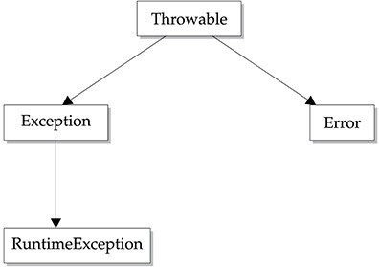
The top-level exception class hierarchy

Slide 88
Java’s Built-in Exceptions
Inside the standard package java.lang, Java defines several exception classes.
They can be categorized into
Unchecked Exception
Checked Exception

Slide 89
Unchecked exception
Unchecked exception classes are defined inside java.lang package.
The most general of these exceptions are subclasses of the standard type RuntimeException.
These exceptions need not be included in any method’s
throws listIn the Java language, these are called unchecked exceptions because the compiler does not check to see whether there is a method that handles or throws these exceptions.
If the program has unchecked exception then it will compile without error but exception occurs when program runs.

Slide 90
RuntimeException Hirarchy
java.lang.Object java.lang.Throwable
java.lang.Exception java.lang.RuntimeException
●
●
●

Slide 91
RuntimeException Direct Sub classes
AnnotationTypeMismatchException, ArithmeticException, ArrayStoreException, BufferOverflowException, BufferUnderflowException, CannotRedoException,
CannotUndoException, ClassCastException, CMMException, ConcurrentModificationException, DataBindingException, DOMException, EmptyStackException, EnumConstantNotPresentException, EventException, FileSystemAlreadyExistsException, FileSystemNotFoundException, IllegalArgumentException, IllegalMonitorStateException, IllegalPathStateException, IllegalStateException, IllformedLocaleException, ImagingOpException, IncompleteAnnotationException, IndexOutOfBoundsException, JMRuntimeException, LSException, MalformedParameterizedTypeException, MirroredTypesException, MissingResourceException, NegativeArraySizeException, NoSuchElementException, NoSuchMechanismException, NullPointerException, ProfileDataException, ProviderException, ProviderNotFoundException, RasterFormatException,
17-11R-20e2j2ectedExecutionException, SecurityException, SystemException,
TypeConstraintException, TypeNotPresentException,
15

Slide 92
Checked Exception
There are some exceptions that are defined by java.lang that must be included in a method’s throws list, if a method generates such exceptions and that method does not handle it itself. These are called checked exceptions
Checked exceptions are the exceptions (in java.lang) that are checked at compile time.
If some statement in a method throws a checked exception, then that method must
either handle the exception or
it must specify the exception using throws keyword

Slide 93
Checked Exception
java.lang.Object
java.lang.Throwable java.lang.Exception
java.lang.ReflectiveOperationException java.lang.ClassNotFoundException
●
●
●
●

Slide 94
Checked exceptions Vs Unchecked exceptions
Checked at compile time.(COMPILE TIME EXCEPTIONS)
Not sub class of RunTimeException
The method must either handle the exception or it must specify the exception using throws keyword.
Shows compile error if checked exception is not handled.
E.g. ClassNotFoundException, IOException
NOT checked at compile time.(RUN TIME EXCEPTINS)
Sub class of RunTimeException
It is NOT needed to handle or catch these exceptions
DO NOT Show compile error if exception is not handled. But shows run-time error.
Eg.ArithmeticException,ArrayI ndexOutOfBoundsException

Slide 95
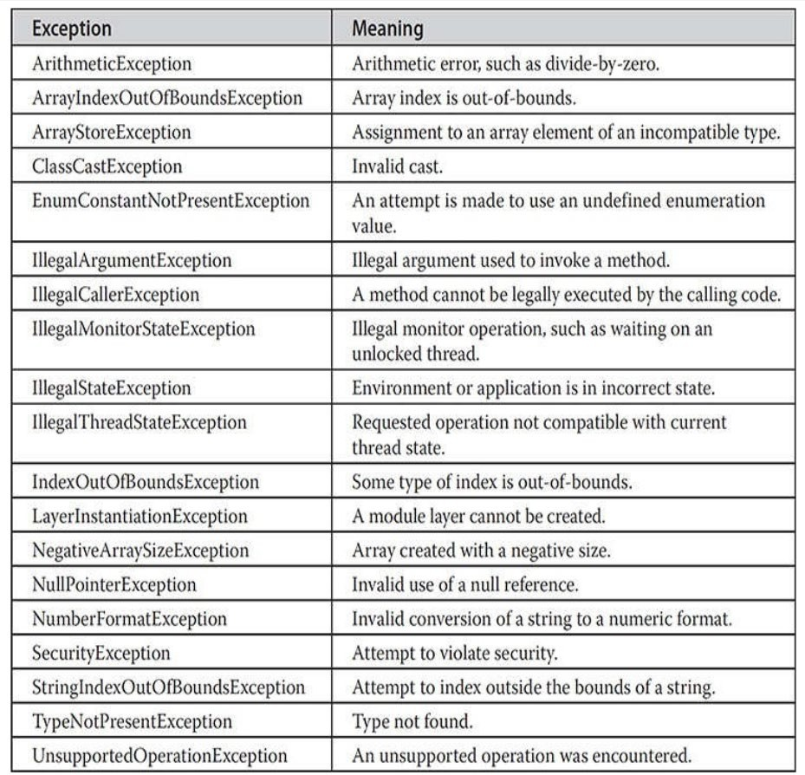
Unchecked Runtime Exception Subclasses Defined in java.lang

Slide 96
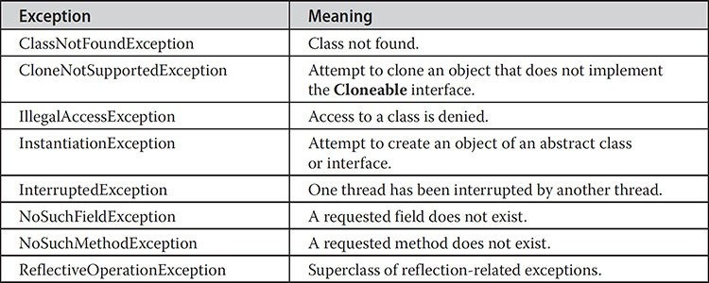
Java’s Checked Exceptions Defined in java.lang

Slide 97
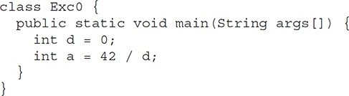
Uncaught Exceptions
Before you learn how to handle exceptions in your program, it is useful to see what happens when you don’t handle them. This small program includes an expression that intentionally causes a divide-by-zero error:
●

Slide 98
Uncaught Exceptions
When the Java run-time system detects the attempt to divide by zero, it constructs a new exception object and then throws this exception.
This causes the execution of Exc0 to stop, because once an exception has been thrown, it must be caught by an exception handler and dealt with immediately
In this example, we haven’t supplied any exception handlers of our own,
so the exception is run-time system.
caught by the default handler
provided by the Java
Any exception that is not caught by your program will ultimately be processed by the default handler. The default handler displays a string describing the exception, prints a stack trace from the point at which the exception occurred, and terminates the program

Slide 99
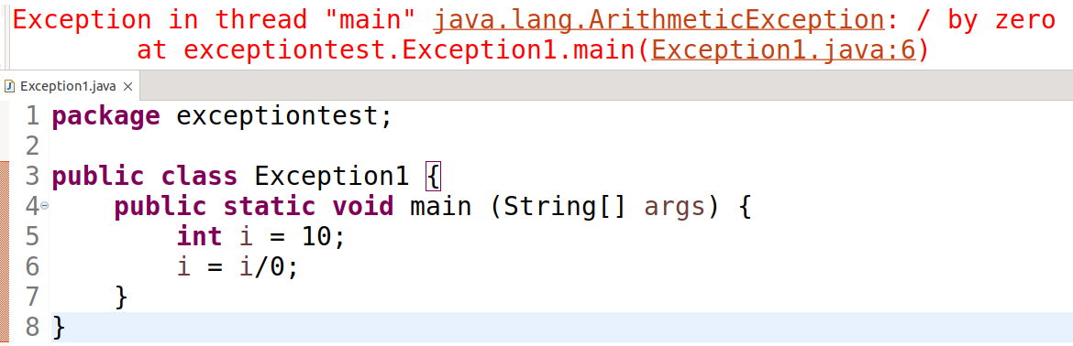
Uncaught Exceptions
●
●
ArithmeticException is a subclass of Exception , which more specifically describes what type of error happened. ArithmeticException.
The stack trace will always show the sequence of method invocations that led up to the error.

Slide 100
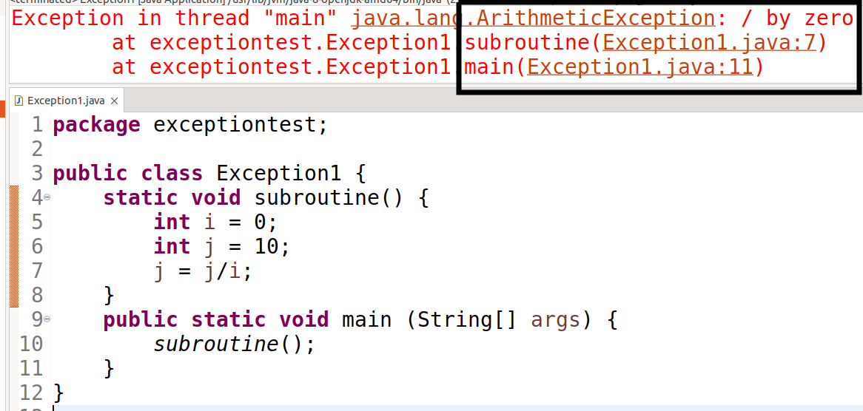
Another Example- StackTrace

Slide 101
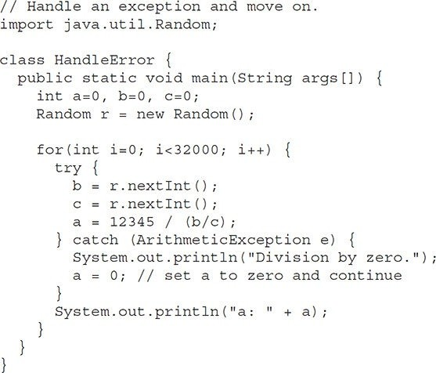
Another example- Handle exception & move on

Slide 102
Exception handling fundamentals

Slide 103
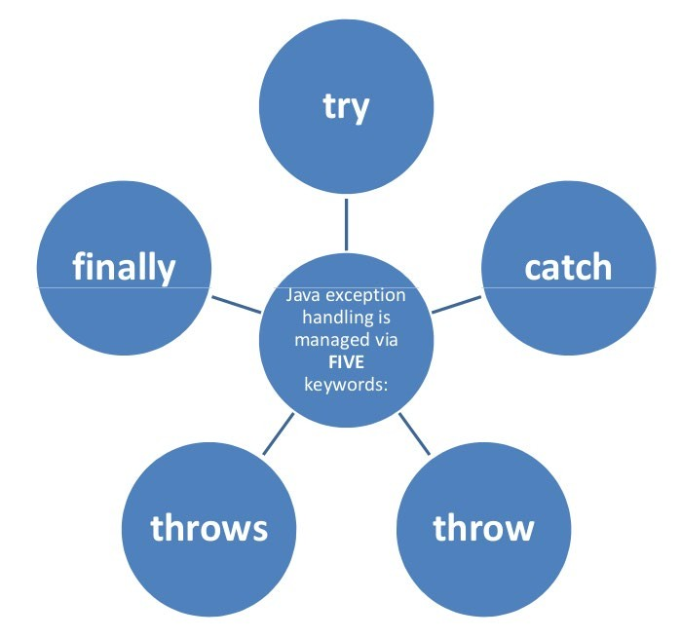
Exception handling fundamentals

Slide 104
Using try and catch
To guard against and handle a run-time error, simply enclose the code that you want to monitor inside a try block. Immediately following the try block,
include a catch clause that specifies the exception type that you wish to catch
Although the default exception handler provided by the Java run- time system is useful for debugging, you will usually want to handle an exception yourself
Doing so provides two benefits
First, it allows you to fix the error
Second, it prevents the program from automatically terminating

Slide 105
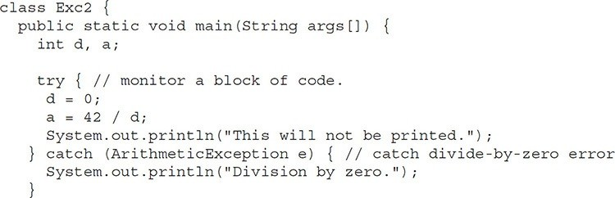
Try-Catch Block
This program generates the following output.
Division by zero
Note: call to println( ) inside the try block is never executed.

Slide 106
Try-catch block
In this program the System.out.println("This will not be printed."); inside the try block is never executed because a = 42 / d;
Once an exception is thrown, program control transfers out of the try block into the catch block.
i.e. catch is not “called” but controls goes out to catch when exception occurs, so execution never “returns” to the try block from a catch.
Thus, the line “This will not be printed.” is not displayed.

Slide 107
Try-Catch Block
Program statements that we want to check for exceptions are written within a try block.
If an exception occurs within the try block, it is thrown.
The code inside catch can catch this exception and handle it in some manner.
System-generated exceptions are automatically thrown by the Java run-time system.
To manually throw an exception, use the keyword throw.
Any exception that is thrown out of a method must be specified as such by a throws clause.

Slide 108
Finally block
finally creates a block of code that will be executed after a try /catch block has completed and before the code following the try/catch block.
The finally block will execute whether or not an exception is thrown.
If an exception is thrown, the finally block will execute even if no catch statement matches the exception.
Any time a method is about to return to the caller from inside atry/catch block, via an uncaught exception or an explicit return statement, the finally clause is also executed just before the method returns.
The finally clause is optional. However, each try statement requires at least one catch or a finally clause.

Slide 109
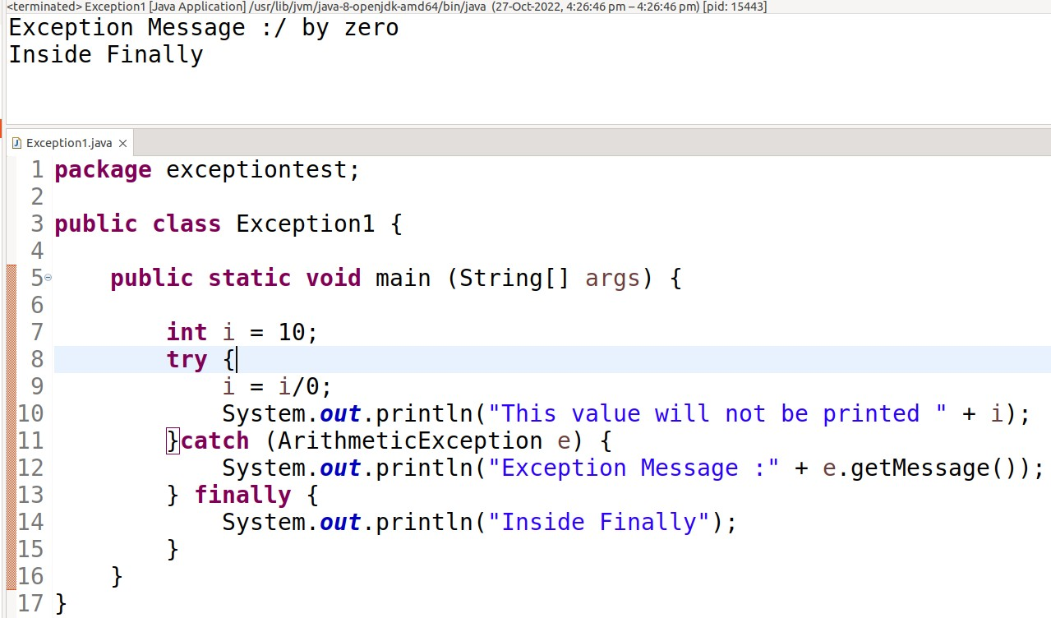
Finally block – Exception
17-11

Slide 110
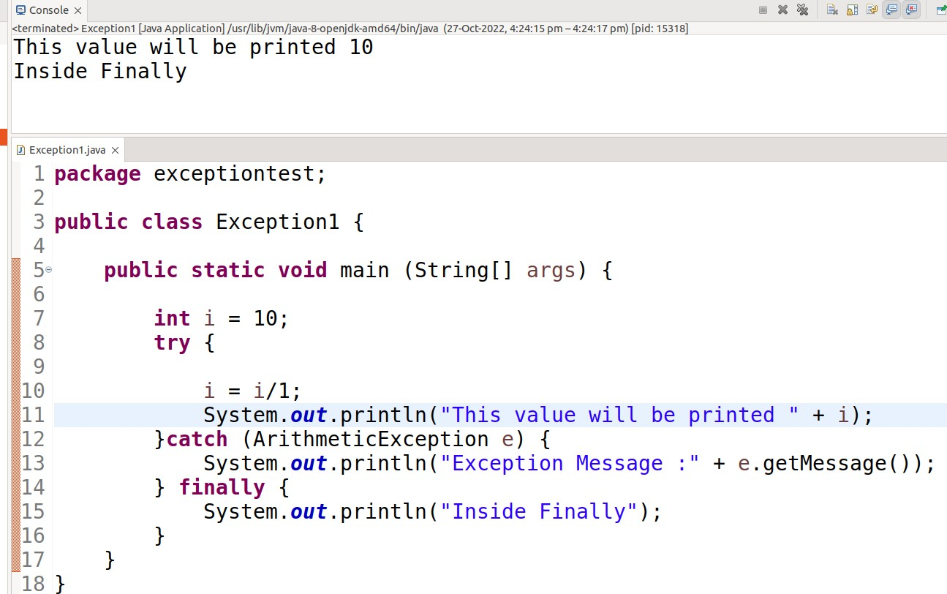
Finally block – No Exception
17-11-
34

Slide 111
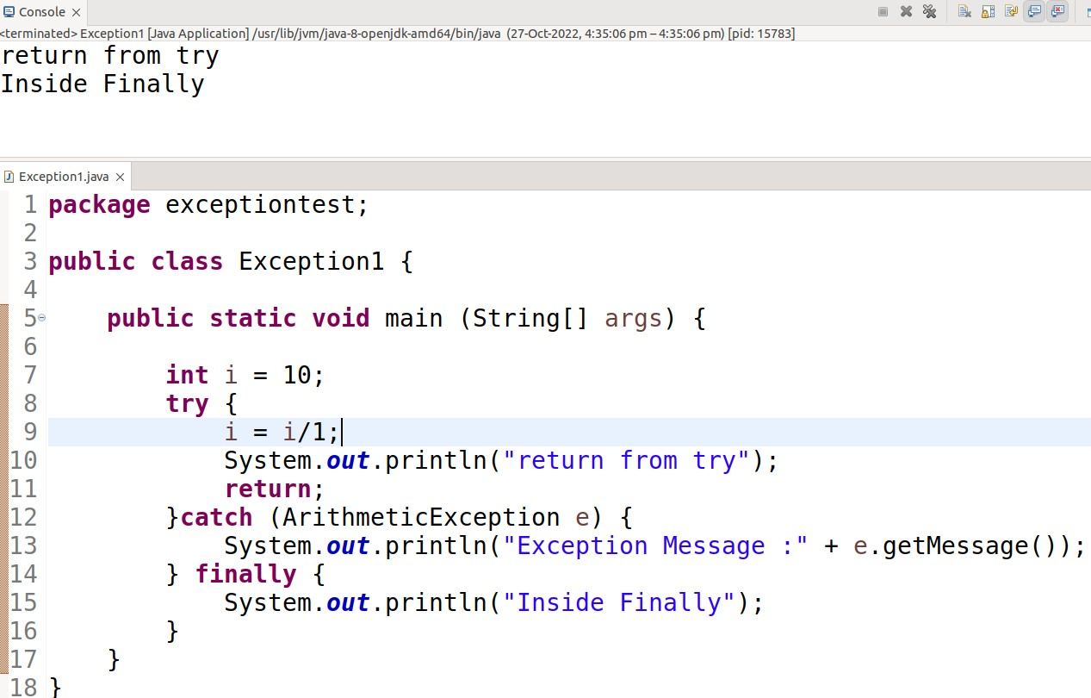
Return from try/catch
17-11
35

Slide 112
throws
If a method is capable of causing an exception that it does not handle, it must specify this behavior so that callers of the method can guard themselves against that exception.
You do this by including a throws clause in the method’s declaration
A throws clause lists the types of exceptions that a method might throw. This is necessary for all exceptions, except those of type Error or RuntimeException, or any of their subclasses
All other exceptions that a method can throw must be declared in the throws clause. If they are not, a compile-time error will result.
17-11-2022
36

Slide 113
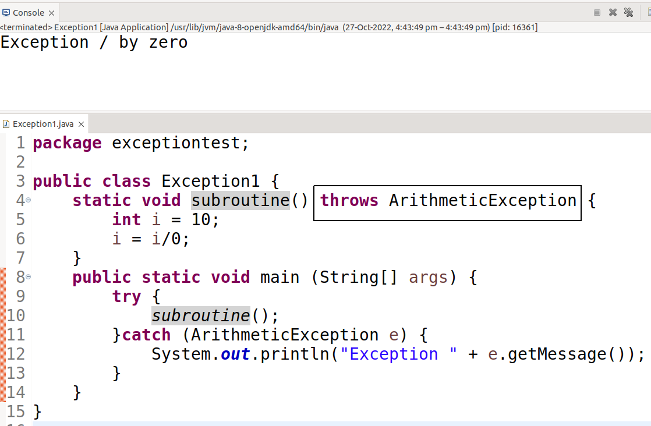
Throws - sample
17-11-
37

Slide 114
throw
So far, you have only been catching exceptions that are thrown by the Java run-time system. However, it is possible for your program to throw an exception explicitly, using the throw statement.
The general form of throw is shown here:
throw ThrowableInstance;
Throwable Instance must be an object of type Throwable or a subclass of Throwable.
Primitive types, such as int or char, as well as non-Throwable classes, such as String and Object, cannot be used as exceptions

Slide 115
throw
There are two ways you can obtain a Throwable object: using a parameter in a catch clause or creating one with the new operator.
The flow of execution stops immediately after the throw statement; any subsequent statements are not executed
The nearest enclosing try block is inspected to see if it has a catch statement that matches the type of exception.
If it does find a match, control is transferred to that statement
f no matching catch is found, then the default exception handler halts the program and prints the stack
trace.

Slide 116
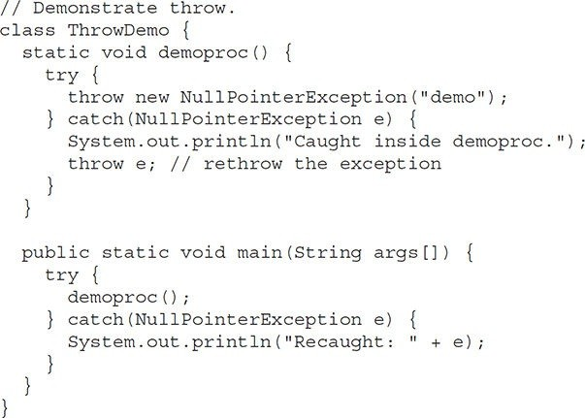
Throw -sample

Slide 117
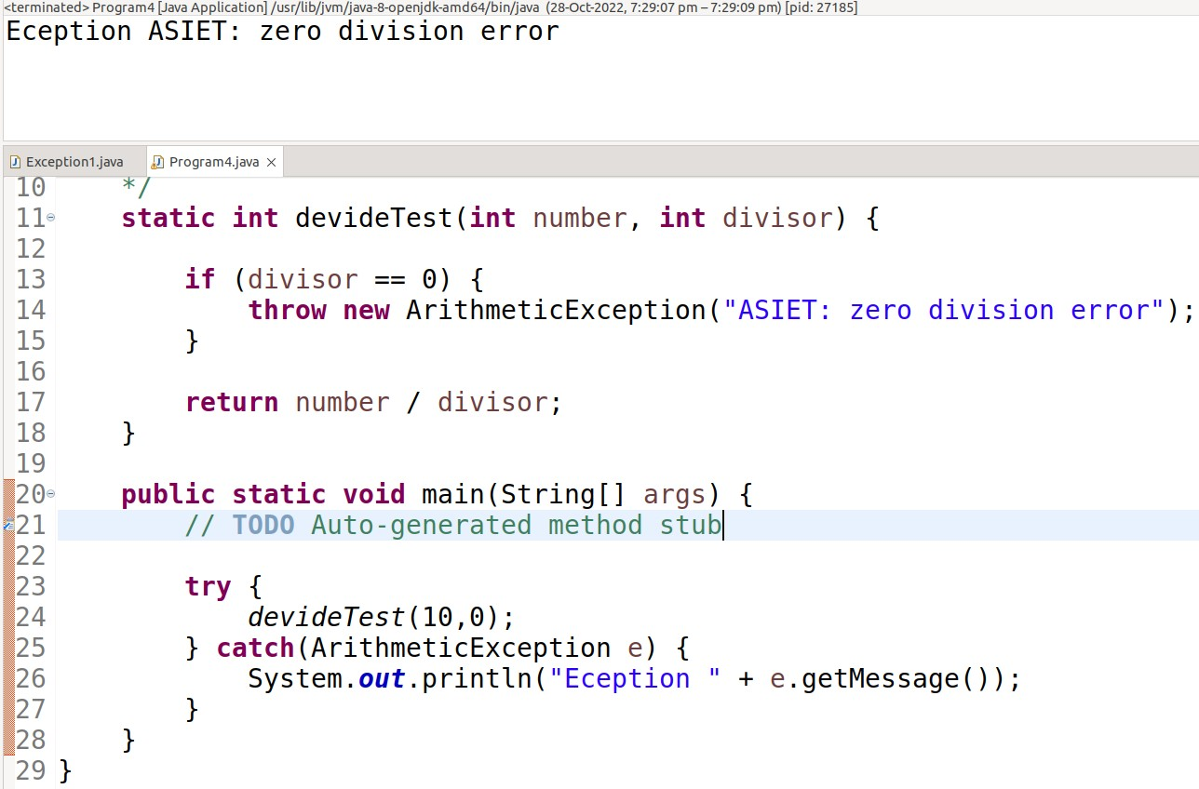
Throw – sample 2

Slide 118
Multicatch Eexceptions

Slide 119
Multiple Catch
In some cases, more than one exception could be raised by a single piece of code.
To handle this type of situation, you can specify two or more catch clauses, each catching a different type of exception.
When an exception is thrown, each catch statement is inspected in order, and the first one whose type matches that of the exception is executed.
After one catch statement executes, the others are bypassed, and execution continues after the try / catch block.

Slide 120
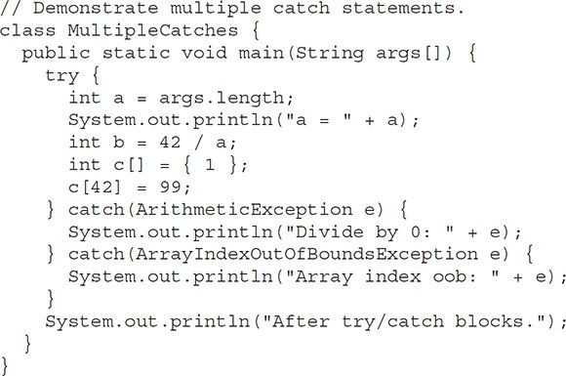
Multi catch – Sample 1

Slide 121
Multi catch – Sample 1
This program will cause a division-by-zero exception if it is started with no command-line arguments, since a will equal zero.
It will survive the division if you provide a command-line argument, setting a to something larger than zero.
But it will cause an ArrayIndexOutOfBoundsException, since the int array c has a length of 1, yet the program attempts to assign a value to c[42].
Here is the output generated by running it both ways:

Slide 122
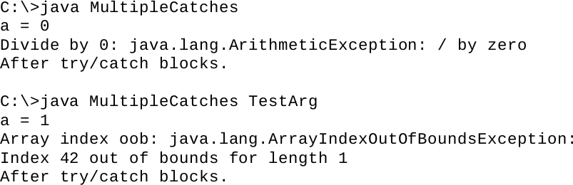
Sample 1- Results
●
●

Slide 123
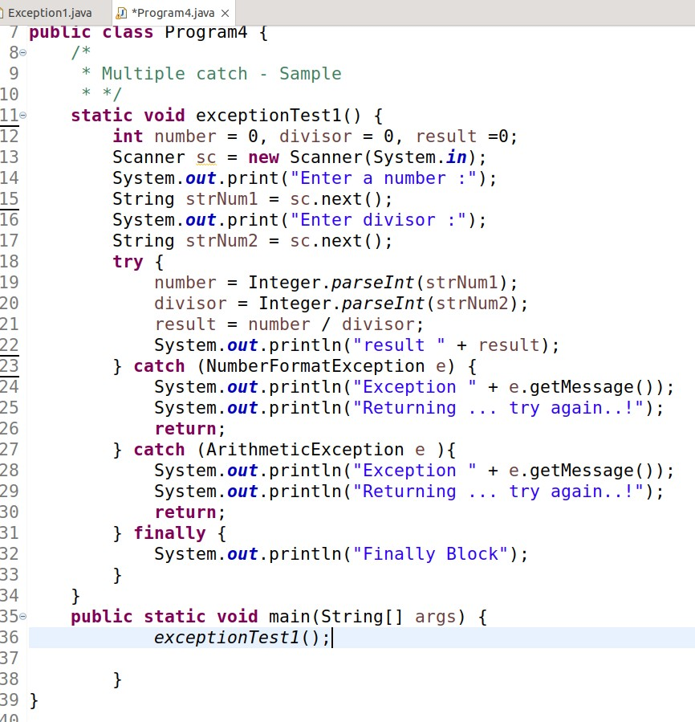
Sample 2

Slide 124
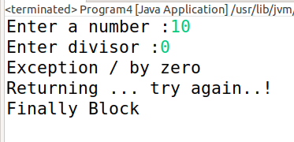
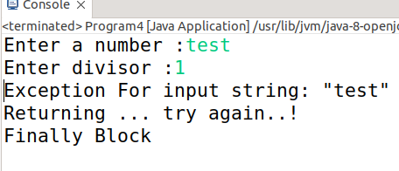
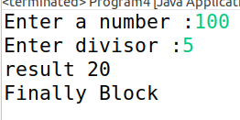
Sample 2 - Result
Test 1
Test 2
●
●
●
●
Test 3
●

Slide 125
Exception Order
When you use multiple catch statements, it is important to remember that exception subclasses must come before any of their superclasses
This is because a catch statement that uses a superclass will catch exceptions of that type plus any of its subclasses.
Thus, a subclass would never be reached if it came after its superclass. Further, in Java, unreachable code is an error

Slide 126
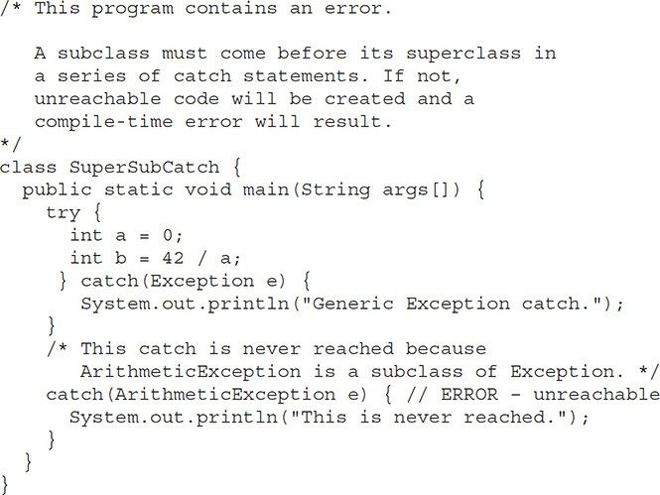
Sample – Error condition

Slide 127
Explanation
f you try to compile this program, you will receive an error message stating that the second catch statement is unreachable because the exception has already been caught.
Since ArithmeticException is a subclass of Exception, the first catch statement will handle all Exception-based errors, including ArithmeticException. \
This means that the second catch statement will never execute.
To fix the problem, reverse the order of the catch statements.

Slide 128
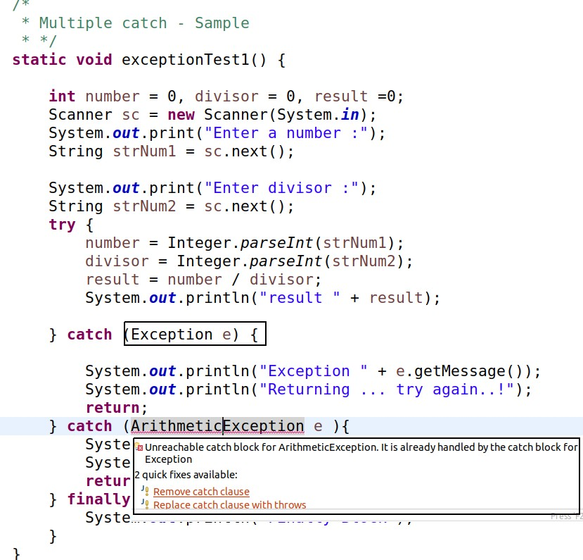
Another Program – Error condition

Slide 129
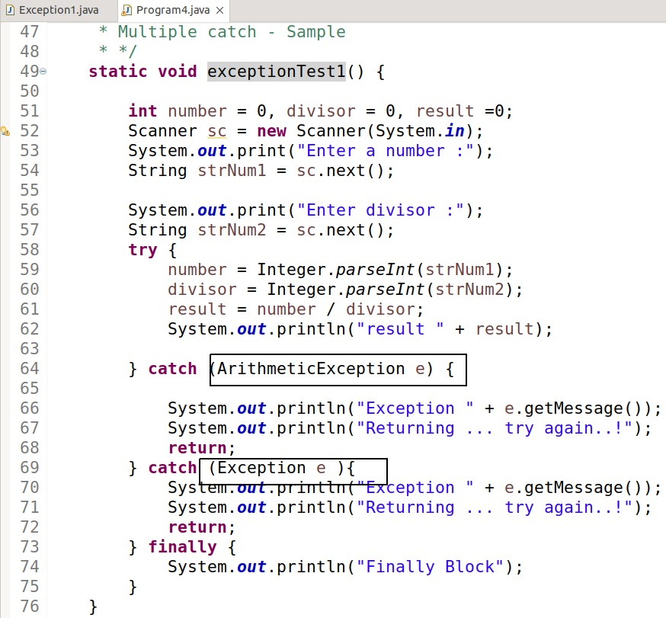
Sample - Fix

Slide 130
Nested Try

Slide 131
Nested Try Statement
The try statement can be nested. That is, a try statement can be inside the block of another try
Each time a try statement is entered, the context of that exception is pushed on the stack.
If an inner try statement does not have a catch handler for a particular exception, the stack is unwound and the next try statement’s catch handlers are inspected for a match.
This continues until one of the catch statements succeeds, or until all of the nested try statements are exhausted.
If no catch statement matches, then the Java run-time system will handle the exception.

Slide 132
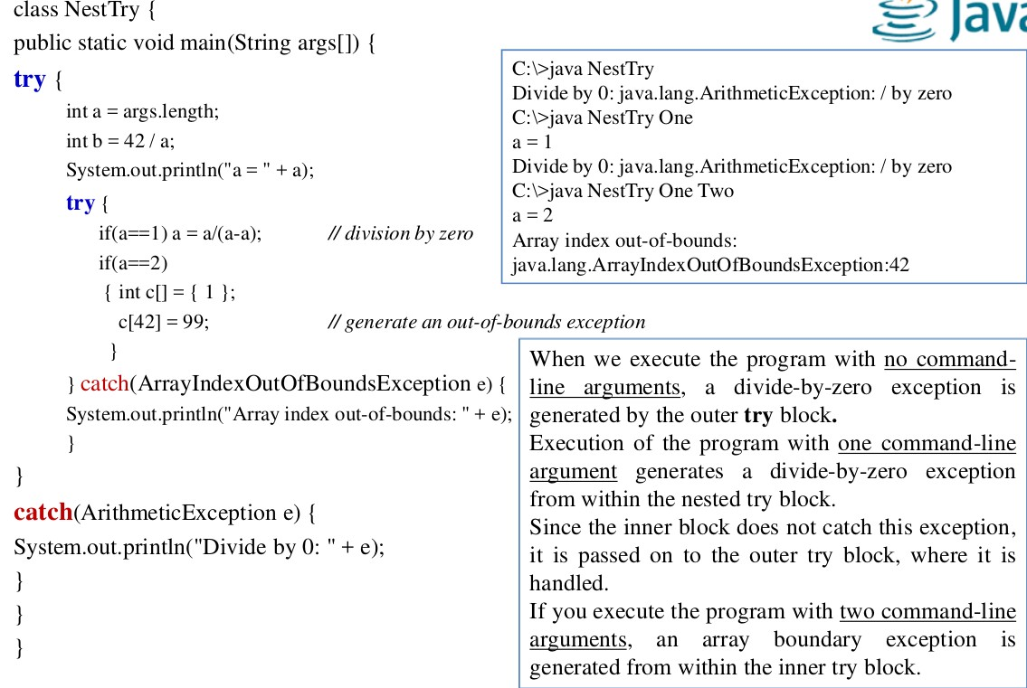
Nested Try
17-11-
56

Slide 133
Another example – Nested via Call to method
We can enclose a call to a method within a try block.
Inside that method we can have another try statement.
In this case, the try within the method is still nested inside the outer try block, which calls that method.

Slide 134
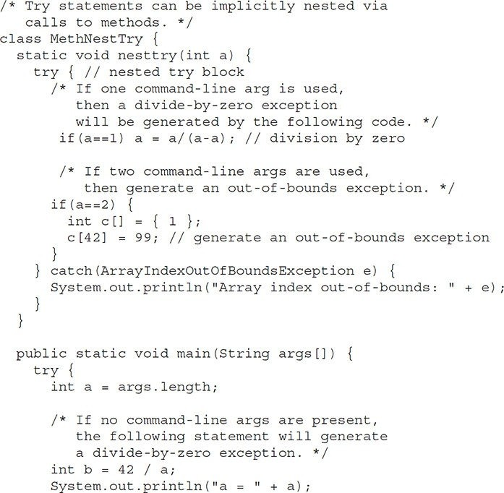
Nested Via Calls to method

Slide 135
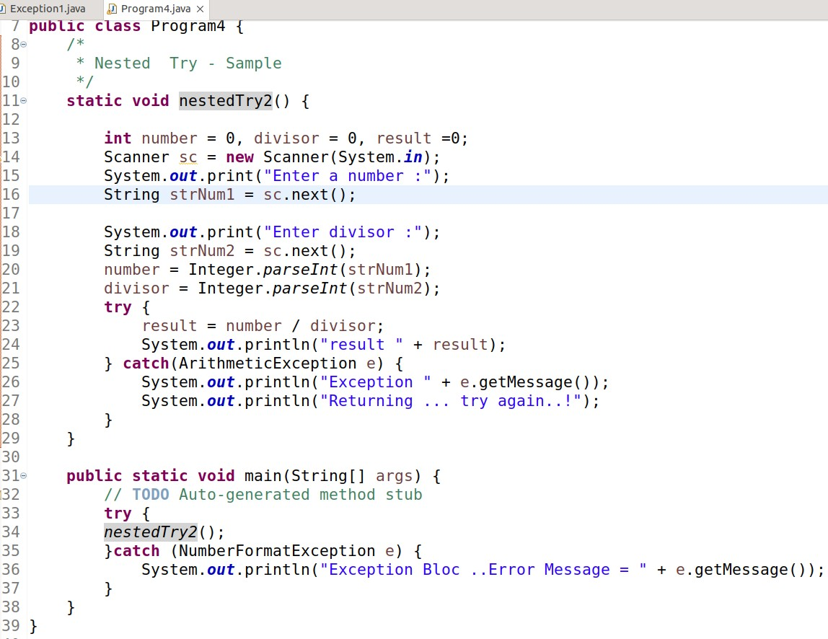
Another Sample – Nested try

Slide 136
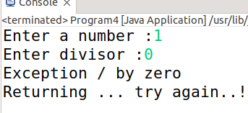
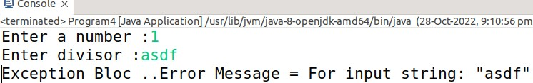
Output
Test 1
●
Test 2

Slide 137
Reference
Herbert Schildt, Java: The Complete Reference, 8/e, Tata McGraw Hill, 2011.

Slide 138
Java - Input/Output Basics
<date/time>
<footer>
1

Slide 139
I/O Basics

Slide 140
I/O Basics
Only print( ) and println( ) are used frequently.
All other I/O methods are not used significantly
Because most real applications of Java are not text-based, console programs.
Most of applications are GUI Based, such as Swing, AWT,JavaFX
Java’s support for console I/O is limited.

Slide 141
Streams
Java programs perform I/O through streams.
A stream is linked to a physical device by the Java I/O system.
physical device are disk file, keyboard, or a network socket.
A stream is an abstraction that either produces or consumes information from / to physical devices.
Input stream may refer to different kinds of input:
from a disk file, a keyboard, or a network socket
Output stream may refer to
the console, a disk file, or a network connection.

Slide 142
Streams ...
All streams behave in the same manner, even ifthe actual physical devices to which they are linked differ.
the same I/O classes and methods can be applied to different types of devices.
This means that an input stream can abstract many different kinds of input: from a disk file, a keyboard, or a network socket
Streams are a clean way to deal with input/output without having every part of your code understand the difference between a keyboard and a network, for example.
Java implements streams within class hierarchies defined in the java.io package.

Slide 143
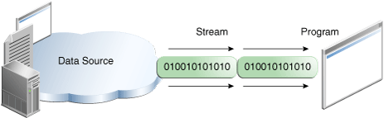
Java Input Streams
Reading information into a program

Slide 144

Java Output Streams
Writing information from a program.

Slide 145

Java IO Streams

Slide 146
Stream Classes
Java defines two types of stream classes
Byte streams: provide a convenient means for handling input and output of bytes. Byte streams are used, for example, when reading or writing binary data
Character streams: provide a convenient means for handling input and output of characters. They use Unicode and, therefore, can be internationalized. Also, in some cases,
They are used to create several concrete stream subclasses. Although your programs perform their I/O operations through concrete subclasses, the top-level classes define the basic functionality common to all stream classes.
character streams are more efficient than byte streams

Slide 147

Java Stream class Hirarchy

Slide 148
The Byte Stream Classes

Slide 149
The Byte Stream Classes
Byte streams are defined by using two class hierarchies which are two abstract classes at the top,
InputStream
OutputStream.
Each of these abstract classes has several concrete subclasses that handle the differences among various devices, such as disk files, network connections, and even memory buffers.
Two of the most important are read( ) and write( ),
– These methods are overridden by derived stream classes, such as FileInputStream, FileOutputStream..and so on.

Slide 150

Byte Stream Classes
17-11
13

Slide 151
InputStream/OutputStream Classes
InputStream and OutputStream are abstract classes that defines Java’s model of streaming byte input and output. It implements the Closeable interfaces.
Most of the methods in this class will throw an IOException when an I/O error occurs.
Calss definition
public abstract class InputStream extends Object implements Closeable
public abstract class OutputStream extends Object implements Closeable
A Closeable is a source or destination of the data that needs to be closed. The close() method is invoked when we need to release resources that are being held by objects such as open files.

Slide 152

InputStream

Slide 153

OutputStream

Slide 154
Sub classes
FileInputStream: lass creates an InputStream that you can use to read bytes from a file. Two constructors are shown here, Either can throw a FileNotFoundException
FileInputStream(String filePath)
FileInputStream(File fileObj)
FileOutputStream: creates an OutputStream that you can use to write bytes to a file. Four of its constructors are shown here:
FileOutputStream(String filePath)
FileOutputStream(File fileObj)
FileOutputStream(String filePath, boolean append)
FileOutputStream(File fileObj, boolean append)

Slide 155

Example 1

Slide 156
Program Output
Xanadu.txt
In Xanadu did Kubla Khan A stately pleasure-dome decree: Where Alph, the sacred river, ran Through caverns measureless to man Down to a sunless sea.
Outagain.txt
In Xanadu did Kubla Khan A stately pleasure-dome decree: Where Alph, the sacred river, ran Through caverns measureless to man Down to a sunless sea.

Slide 157

Program - Logic
CopyBytes spends most of its time in a simple loop that reads the input stream and writes the output stream, one byte at a time, as shown in the following figure.

Slide 158

Summary

Slide 159
BufferedInputStream
Extend from FileInputStream
public class BufferedInputStream extends FilterInputStream
Java BufferedInputStream class is used to read information from stream. It internally uses buffer mechanism to make the performance fast.
The important points about BufferedInputStream are:
When the bytes from the stream are skipped or read, the internal buffer automatically refilled from the contained input stream, many bytes at a time.
When a BufferedInputStream is created, an internal buffer array is created.

Slide 160
BufferedOutputStream
Extend from FileOutputStream
public class BufferedOutputStream extends FilterOutputStream
Java BufferedInputStream class is used to write information from stream. It internally uses buffer mechanism to make the performance fast.
By setting up such an output stream, an application can write bytes to the underlying output stream without necessarily causing a call to the underlying system for each byte written

Slide 161
BufferedInputStream Vs FileInputStream
FileInputStream is meant for reading streams of raw bytes from files.
A BufferedInputStream adds functionality to another input stream- namely, the > ability to buffer the input and to support the mark and reset methods.
The Buffered variants add a buffering layer, speeding up IO operations by batching up reads and writes.
Instead of going to disk for every read/write, it goes to memory first. How much of a difference it makes depends on a variety of factors. The OS and/or disk I/O system also likely does some buffering.

Slide 162
DataInputStream
A data input stream lets an application read primitive Java data types from an underlying input stream in a machine-independent way.
An application uses a data output stream to write data that can later be read by a data input stream.

Slide 163
DataOutputStream
A data output stream lets an application write primitive Java data types to an output stream in a portable way.
An application can then use a data input stream to read the data back in.

Slide 164
The Character Streams

Slide 165
Character streams
While the byte stream classes provide sufficient functionality to handle any type of I/O operation, they cannot work directly with Unicode characters.
Since one of the main purposes of Java is to support the "write once, run anywhere" philosophy, it was necessary to include direct I/O support for characters.
At the top of the character stream hierarchies are the Reader and Writer abstract classes.
Two of the most important are read( ) and write( ),
– These methods are overridden by derived stream classes.

Slide 166

Character Streams classes

Slide 167
Reader and Writer Classes
Reader
is an abstract class that defines Java’s model of streaming character input. All of the methods in this class (except for markSupported( )) will throw an IOException on error conditions..
Writer
is an abstract class that defines streaming character output. All of the methods in this class throw an IOException in the case of errors.

Slide 168

Reader Functions

Slide 169

Writer Functions

Slide 170
FileReader Class
The FileReader class creates a Reader that you can use to read the contents ofa file.
Two commonly used constructors are shown here:
FileReader(String filePath)
FileReader(File fileObj)
Either can throw a FileNotFoundException.

Slide 171
FileWriter
FileWriter creates a Writer that you can use to write to a file. Four commonly used constructors are shown here.
FileWriter(String filePath)
FileWriter(String filePath, boolean append)
FileWriter(File fileObj)
FileWriter(File fileObj, boolean append)
They can all throw an IOException. If append is true, then output is appended to the end of the file.
●

Slide 172

Example

Slide 173
The Predefined Streams

Slide 174
The Predefined Streams
All Java programs automatically import the java.lang package. This package defines a class called System.
System contains three predefined stream variables:
in, out, and err.
– These fields are declared as public static final within System.
This means that they can be used by any other part of your program and without reference to a specific System object.

Slide 175
The Predefined Streams
System.out: refers to the standard output stream. By default, this is the console.
System.in refers to standard input, which is the keyboard by default.
System.err refers to the standard error stream, which also is the console by default.
System.in is an object of type InputStream;
System.out and System.err are objects of type PrintStream.
These are byte streams, even though they are typically used to read and write characters from and to the console.

Slide 176
Reading Console Input

Slide 177
Reading Console Input
In the early days of Java, the only way to perform console input was to use a byte stream.
However, for commercial applications, the preferred method of reading console input is to use a character-oriented stream. This makes your program easier to internationalize and maintain.
In Java, console input is accomplished by reading from System.in. To obtain a character-based stream that is attached to the console, wrap System.in in a BufferedReader object.
A commonly used constructor is shown here:
BufferedReader(Reader inputReader)

Slide 178
Reading Console Input ...
BufferedReader(Reader inputReader)
Reader is an abstract class. So object can not be created for Reader class. One of its concrete subclasses is InputStreamReader, which converts bytes to characters.
To obtain an InputStreamReader object that is linked to System.in, use the following constructor
InputStreamReader(System.in)
Putting it all together, the following line of code creates a BufferedReader that is connected to the keyboard:
●

Slide 179
Reading Characters
After this statement executes, br is a character-based stream that is linked to the console through System.in.
To read a character from a BufferedReader, use read( ). The version of read( ) that we will be using is
int read( ) throws IOException
Each time that read( ) is called, it reads a character from the input stream and returns it as an integer value. It returns –1 when an attempt is made to read at the end of the stream.

Slide 180
Reading console-summary
To accept data from keyboard, we use System.in. (bytestream). We need to connect keyboard to an input stream object.
Here we can use InputStreamReader that can read data from the keyboard (convert byte stream to character stream)
Now our data reaches InputSreamReader..
BufferedReader class is used to read the text from a character- based input stream.
To make program run fast and to make reading efficient , buffering can be done using BufferedReader class. It can read data from stream.

Slide 181

Reading console-summary ...2
Create BufferedReader object and connect InputStreamReader object to it.
InputStreamReader in = new InputStreamReader(System.in); BufferedReader br = new BufferedReader(in);
Or
BufferedReader br = new BufferedReader(new InputStreamReader(System.in));

Slide 182
Reading console-summary ...3
BufferedReader br = new BufferedReader(new InputStreamReader(System.in));
System.in -> keyboard(Byte stream)
Convert byte steam to character stream using InputStreamReader. Then wrap that character stream in a buffered strea BufferedReader

Slide 183

Example 1- Read Character

Slide 184

Example 2 – Read String
17-11
47

Slide 185

Example 3- Tiny Editor

Slide 186

Example 3- Tiny Editor - Output

Slide 187

Read Console Input functions

Slide 188
Writing Console Output

Slide 189
Writing Console Output
Console output is usually done through print( ) and println().
These methods are defined by the class PrintStream.
PrintStream is derived from OutputStream
System – is a final class in java.lang package
out – is a static member of System class and is object of PrintStream
println()- is a method of PrintStream which prints whatever is passed to it on the standard output or your screen.
System.out.println()

Slide 190

PrintStream - Constructors

Slide 191
Writing Console Output
Method Overloading in PrintStream Class
println()
println(boolean)
println(char)
println(char[])
println(double)
println(float)
println(int)
println(long)
println(java.lang.Object)
println(java.lang.String)

Slide 192
PrintStream is derived from OutputStream
PrintStream also implements the low-level method write( )
write( ) can be used to write to the console

Slide 193
Writing Console Output
PrintStream method overloading for write
public void write(int b) throws IOException
public void write(int b) throws IOException
public void write(byte[] b, int off, int len) throws IOException

Slide 194

Console Write

Slide 195

Console Write
Need to enable automatic flush
That is, flush the content of the buffer to the output device automatically.
Will display in device console only if buffer is flushed
The auto flush will happen when the buffer is full.
Buffer is full detected by
When find a new line char - ‘/n’
Or can flush explicitely call out.flush()
Println() will do flush implicitely
So no need to call flush, or \n

Slide 196
PrintWriter class

Slide 197
PrintWriter class
For real-world programs, the recommended method of writing to the console using Java is through a PrintWriter stream.
Prints formatted representations of objects to a text-output stream.
This class implements all of the print methods found in PrintStream.
It does not contain methods for writing raw bytes, for which a program should use unencoded byte streams.

Slide 198
PrintWriter class
Got many Constructors, one is given here
PrintWriter(OutputStream outputStream, boolean flushOnNewline)
Here, outputStream is an object of type OutputStream, and flushOnNewline controls whether Java flushes the output stream every time a println( ) method is called.
– If flushOnNewline is true, flushing automatically takes place.
If false, flushing is not automatic.

Slide 199
PrintWriter class
Unlike the PrintStream class, if automatic flushing is enabled it will be done only when one of the println, printf, or format methods is invoked, rather than whenever a newline character happens to be output.
These methods use the platform's own notion of line separator rather than the newline character.

Slide 200

PrintWriter class
11-2022

Slide 201
PrintWriter class
PrintWriter supports the prin) and println( ) methods
If an argument is not a simple type, the PrintWriter methods call the object’s toString( ) method and then print the result.
To write to the console by using a PrintWriter, specify System.out for the output stream and flush the stream after each new line.
PrintWriter pw = new PrintWriter(System.out, true);
●

Slide 202

PrintWriter class
17-11-

Slide 203
PrintStream Vs PrintWriter
PrintStream and PrintWriter have nearly identical methods.
PrintStream prints to an OutputStream, and PrintWriter prints to a Writer
Both are streams, with the primary difference being a OutputStream is a stream of bytes while a Writer is a stream of characters.
PrintStream.print(String)? -> It converts chars to bytes using the default platform encoding.
Linux represents Unicode using the 8-bit Unicode Transformation Format (UTF-8)

Slide 204
PrintStream Vs PrintWriter
With a PrintWriter, you typically specify the encoding to use, avoiding any platform dependencies.
OutputStream os = new FileOutputStream("file.txt");
PrintWriter pw = new PrintWriter(new OutputStreamWriter(os, StandardCharsets.UTF_8));
Essentially the difference is that PrintStream writes raw bytes in the machine's native character format, and PrintWriter converts bytes to recognized encoding schemes.

Slide 205
Reference
Reference
Herbert Schildt, Java: The Complete Reference, 8/e, Tata McGraw Hill, 2011.

